Slide 1




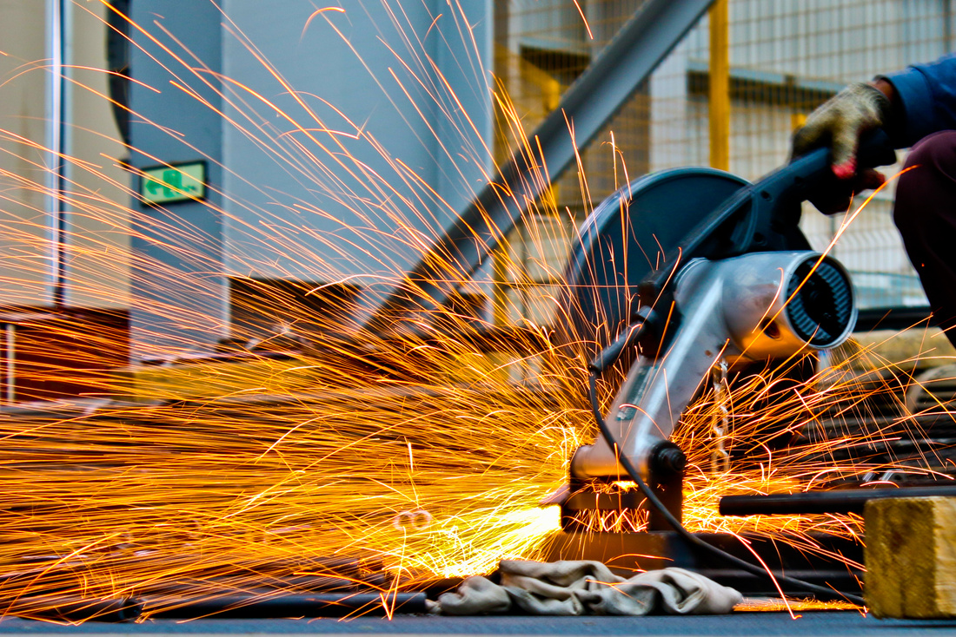
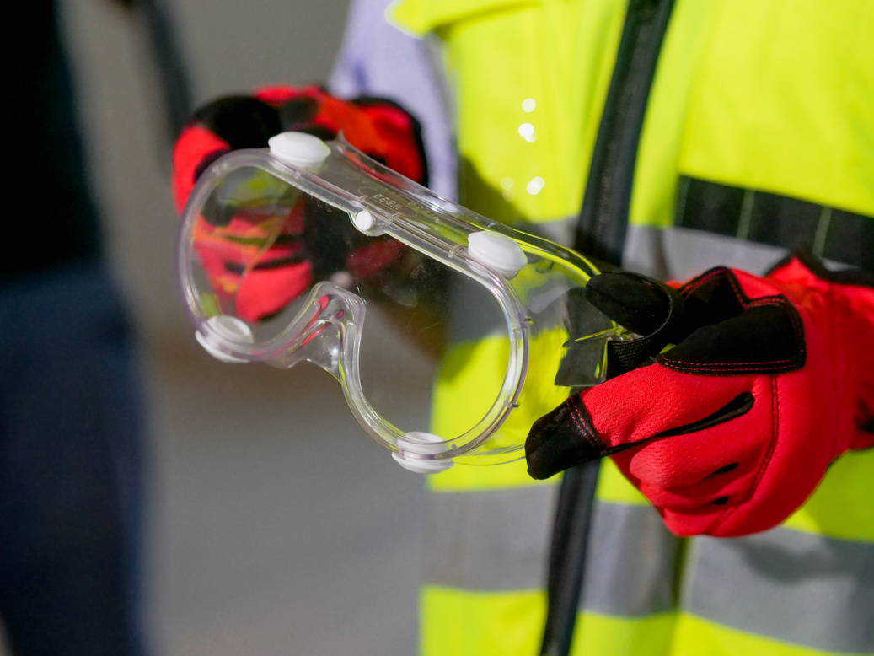
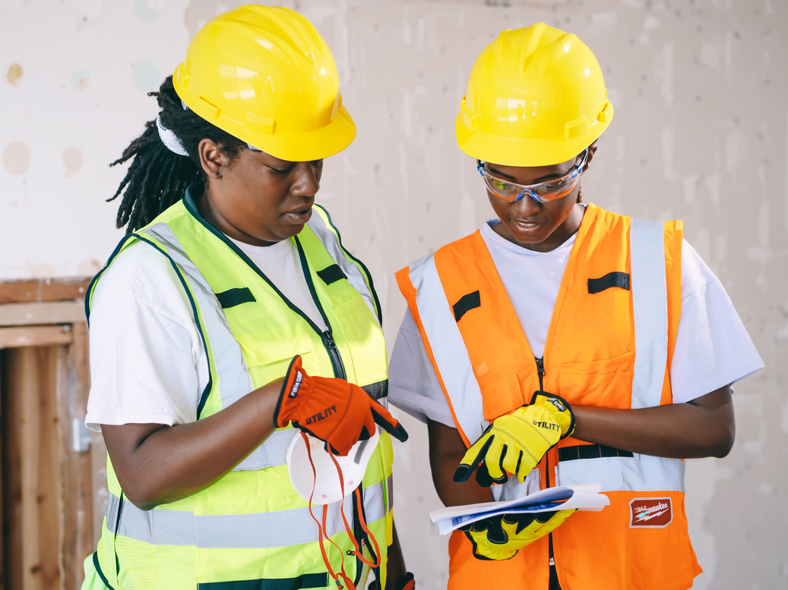
PPE SYSTEM
Home
Services
Features
About Us
Let’s Talk
WORKPLACE SAFETY PPE DETECTION SYSTEM
Midterm Project Proposal - ITAI 1378: Comp Vision-Artificial Intel
Team Members:
DeMarcus Crump
Chloe Tu
Project Tier: Tier 2
Date: October 30, 2025

Slide 2


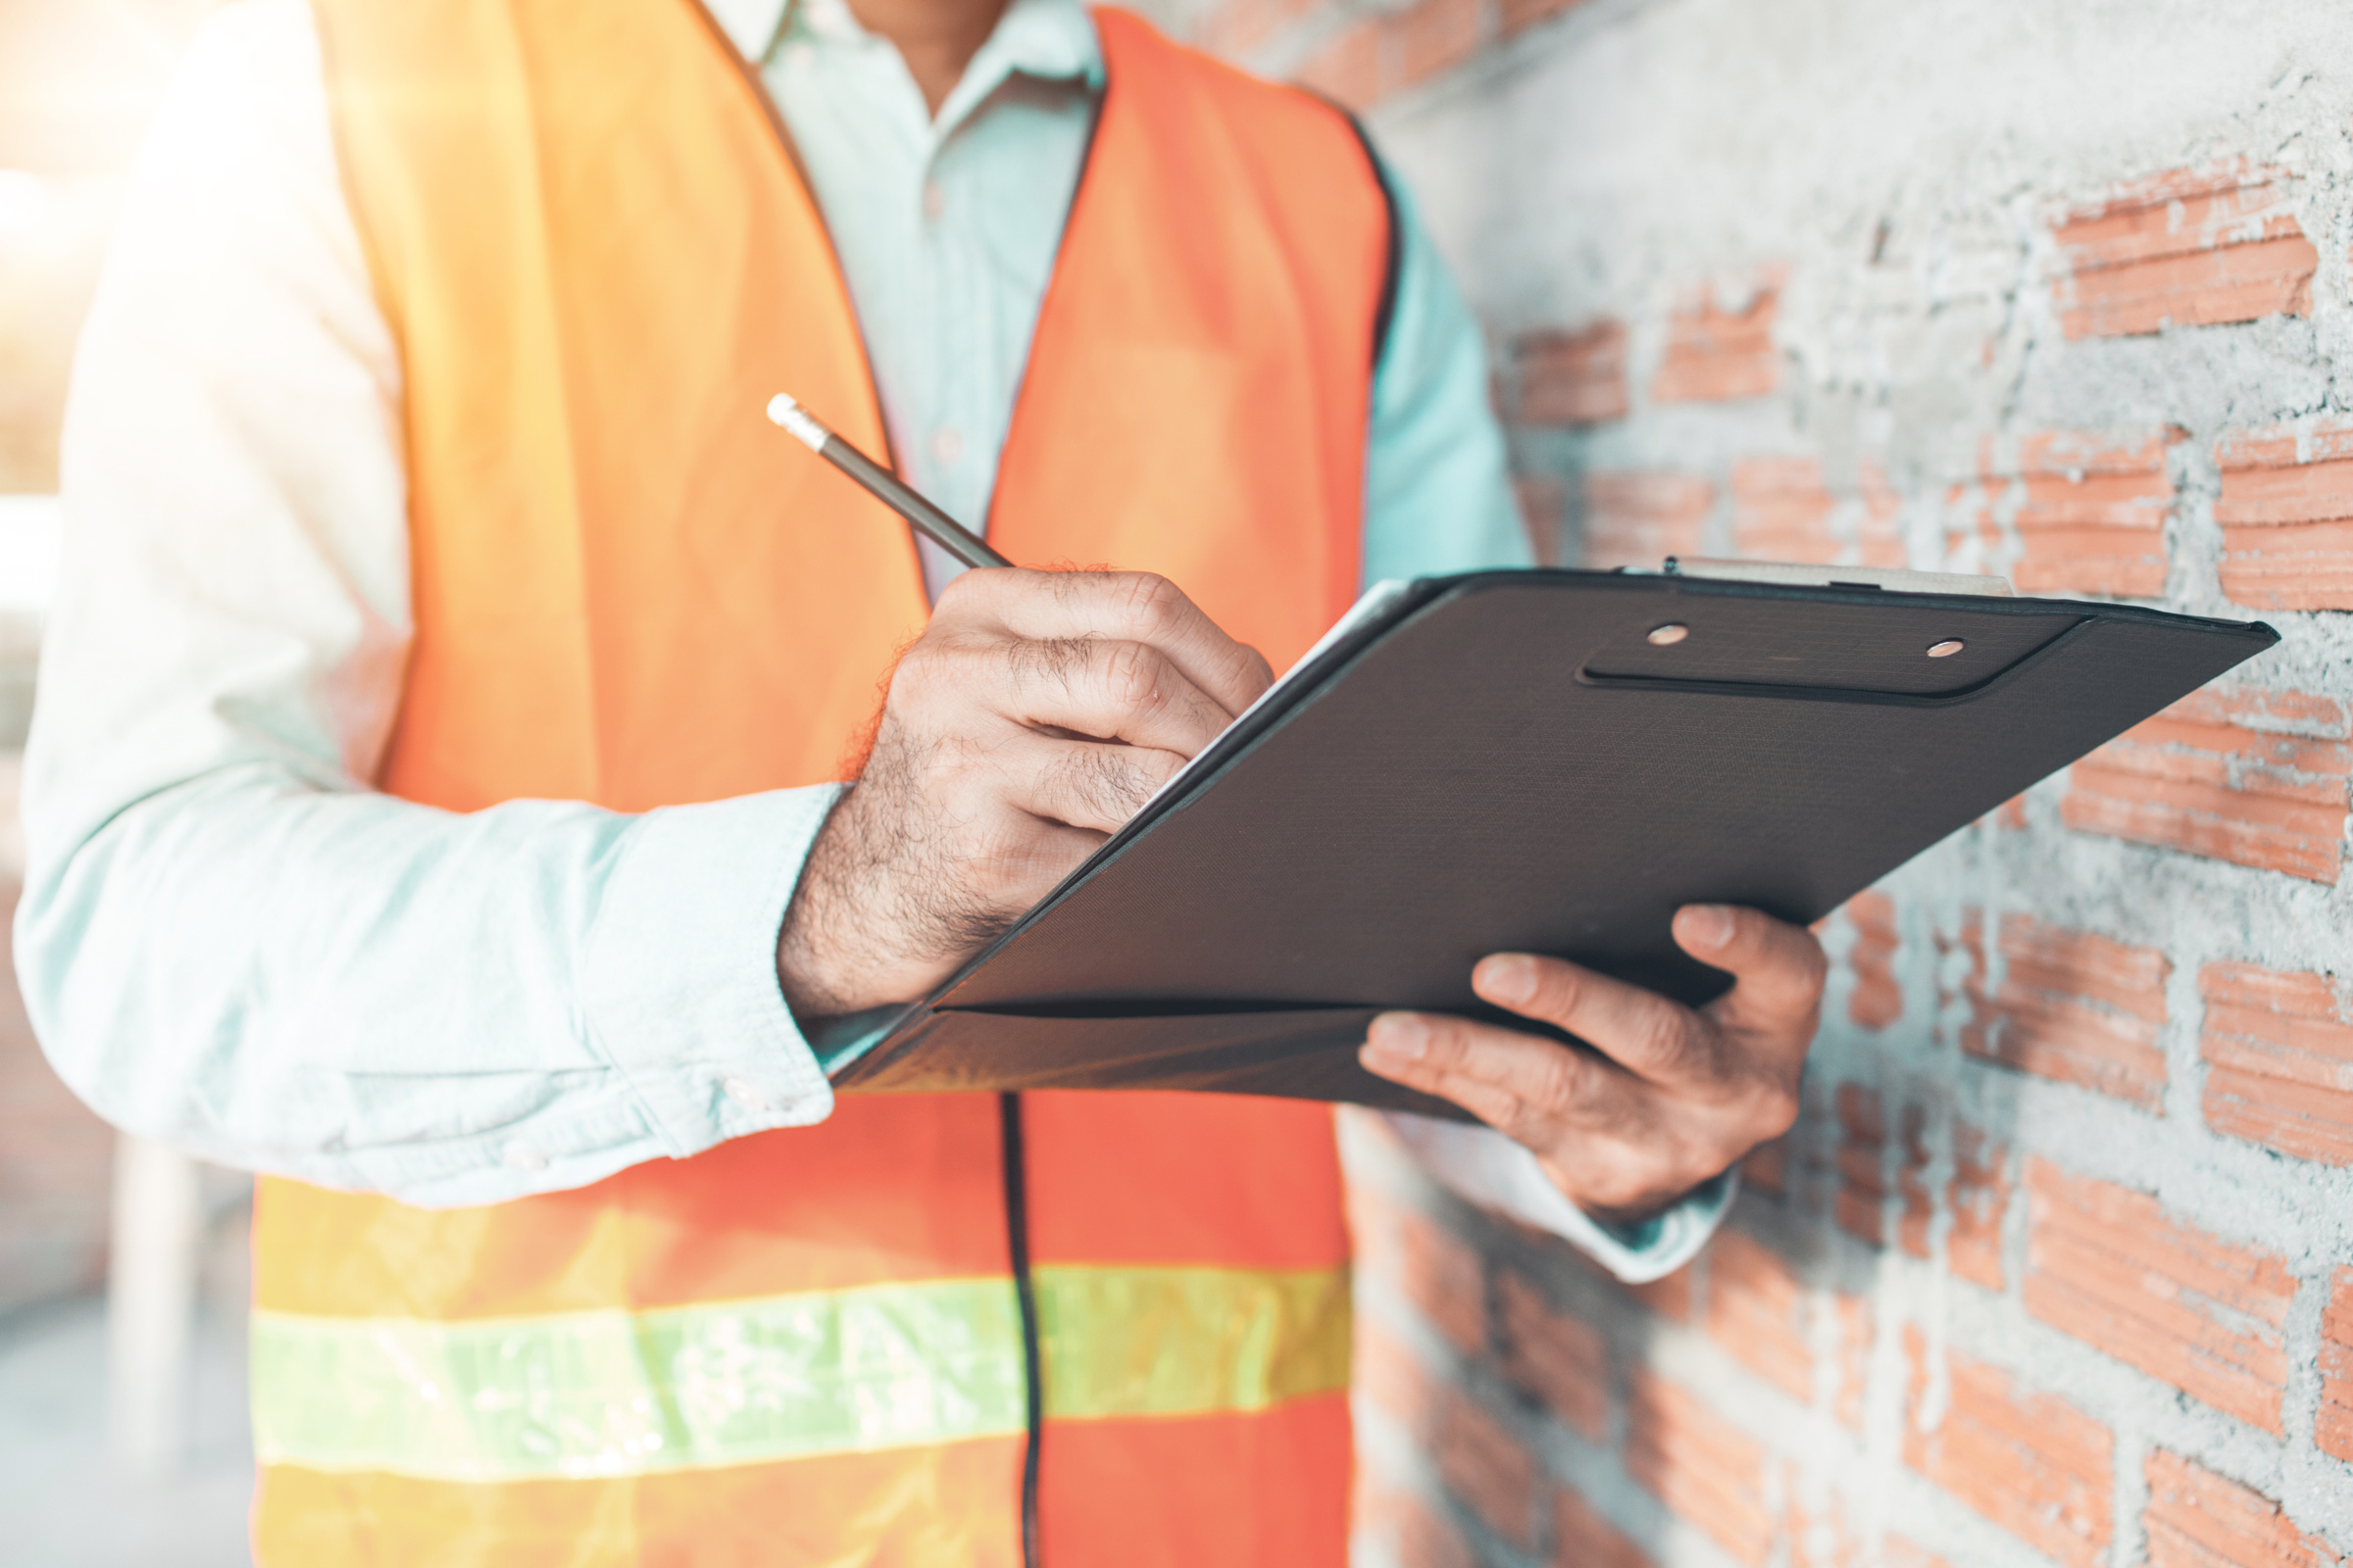
PPE SYSTEM
Home
Services
Features
About Us
Let’s Talk
THE PROBLEM
What problem are you solving?
Failure to wear required Personal Protective Equipment (PPE) on construction sites leads to preventable injuries, deaths, and costly OSHA penalties. Manual monitoring is inconsistent and error-prone.
Who cares about this problem?
Construction/safety managers - enforce compliance
OSHA/government agencies - regulatory compliance
Workers - personal safety
Insurance companies - reduce injury claims
Employers - avoid penalties and costs
Why is it important?
Key Statistics:
4,764 workers died on the job in 2020 (US); nearly half in construction/material-moving [OSHA, BLS]
$1 billion per week in direct worker compensation costs for serious injuries
70% of fall incidents involve lack of PPE
Only 60% of workers consistently wear required PPE
Average injury cost: ~$42,000
Death cost: >$1.3 million
OSHA penalties: $15,625–$156,259 per violation
Business Impact: Automated detection reduces injuries, cuts insurance costs, ensures OSHA compliance, and saves millions annually.

Slide 3
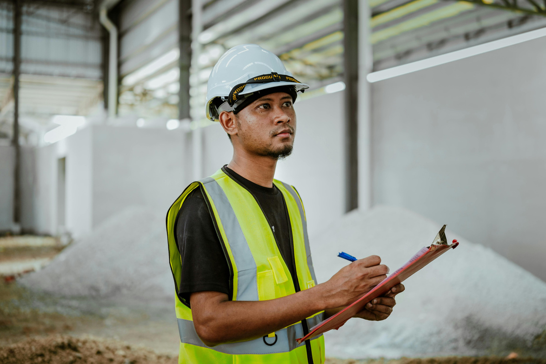
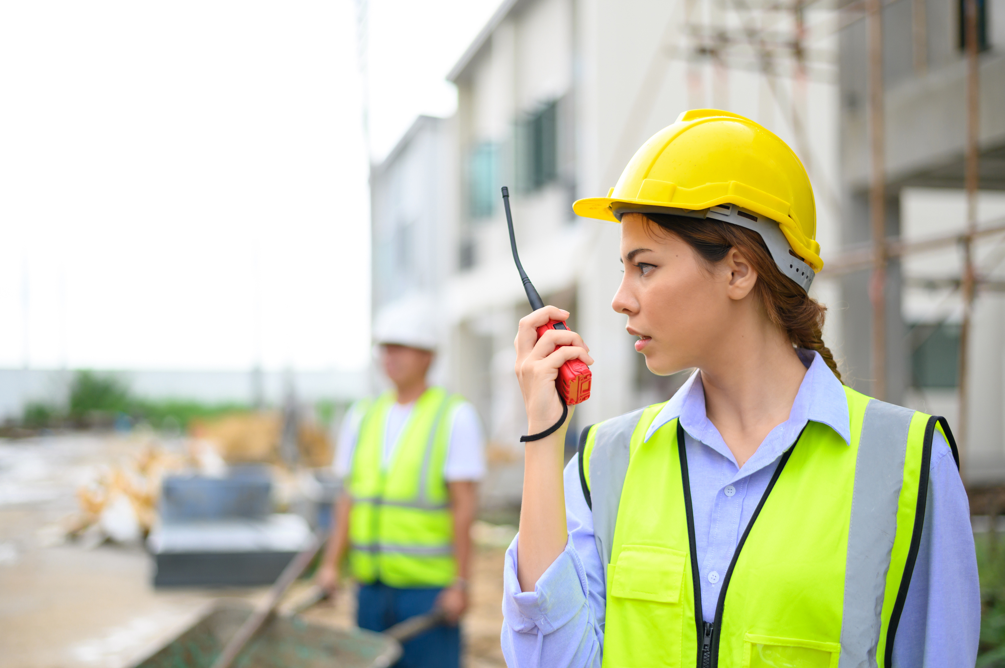
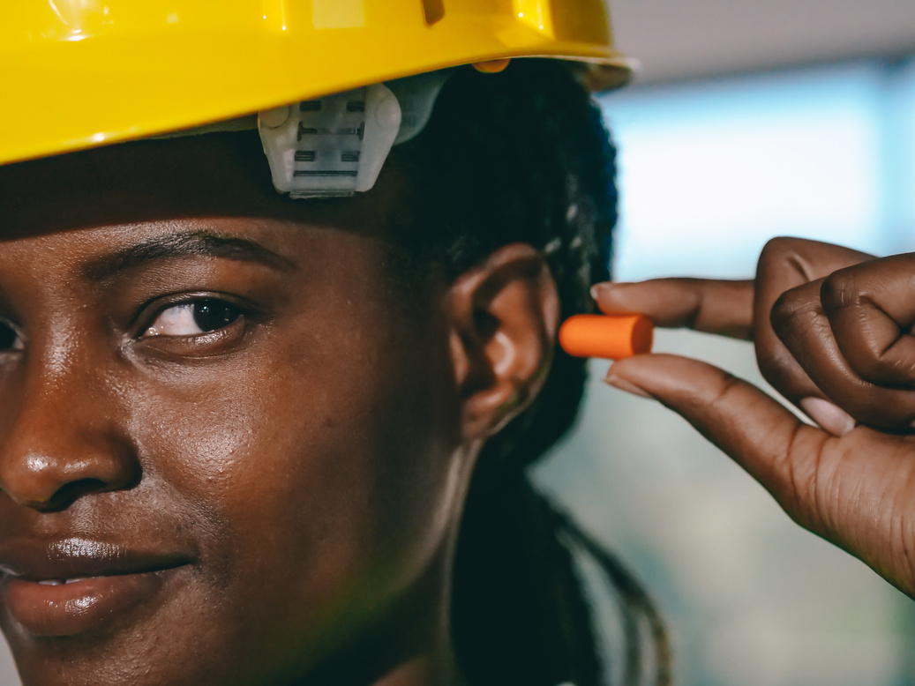
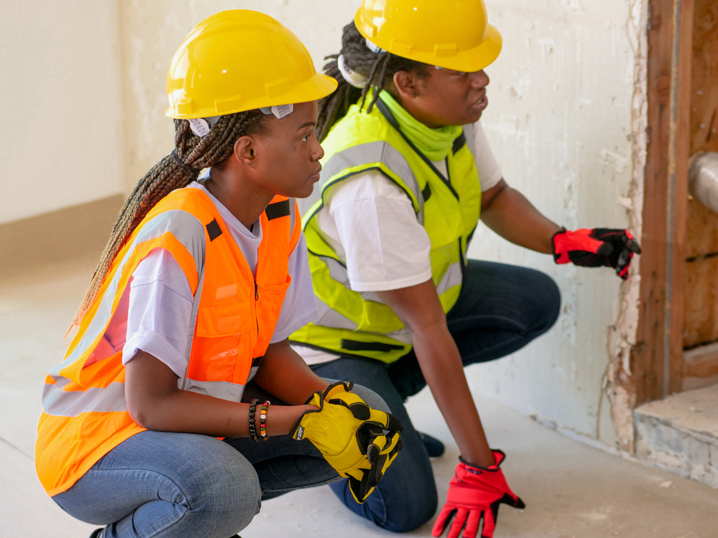
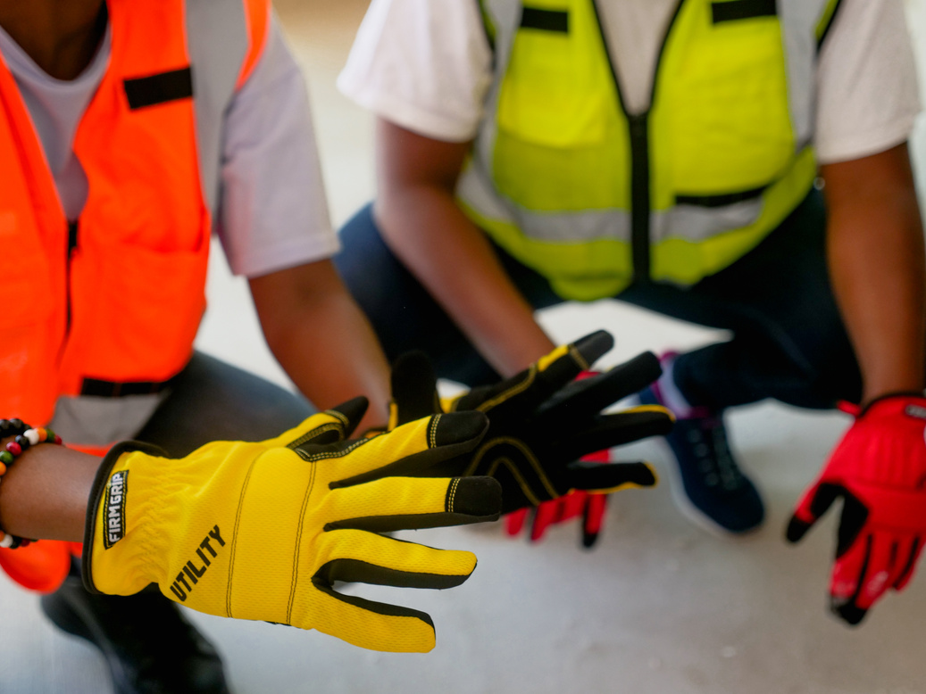
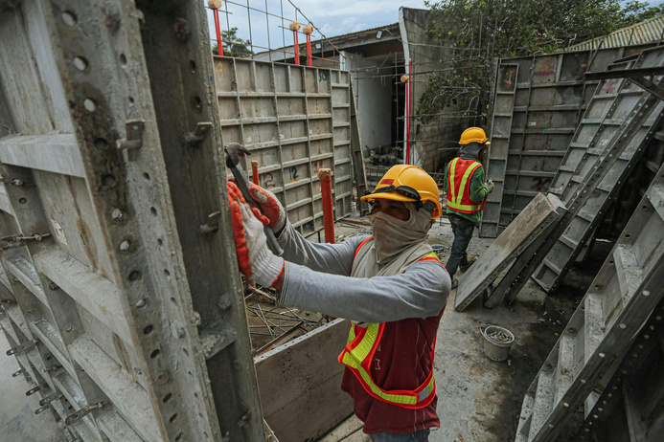
PPE SYSTEM
Home
Services
Features
About Us
Let’s Talk
How will it solve the problem?
YOUR SOLUTION (OVERVIEW)
Simple Workflow:
1. Camera Feed (Image/Video)
2. YOLOv8 Object Detection (detect helmets, vests, masks, etc.)
3. Compliance Rule Engine (check: helmet ✓, vest ✓, mask ✓)
What will your system do?
One-Sentence Summary: A real-time computer vision system that detects PPE on workers, verifies compliance, and generates alerts/reports for violations.
4. Annotated Image + Compliance Report
Benefits:
Automated continuous monitoring
Real-time violation detection
Data-driven safety reports
Reduced risk of accidents
5. Real-Time Alerts for Violations

Slide 4
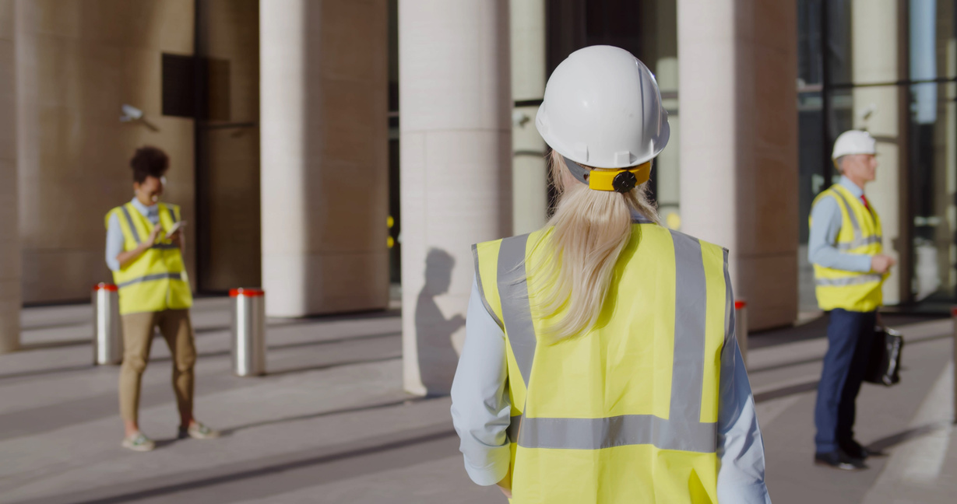
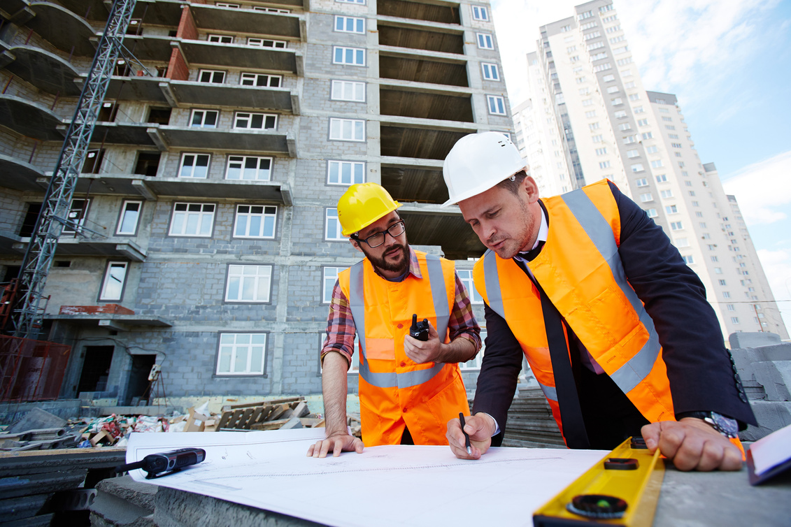
PPE SYSTEM
Home
Services
Features
About Us
Let’s Talk
TECHNICAL APPROACH
Technique
Object Detection: Multi-class detection of PPE items and workers
Model
YOLOv8 (You Only Look Once, version 8)
Why YOLOv8:
State-of-the-art accuracy (90%+ mAP on benchmarks)
Real-time performance (30+ FPS on GPU; 10+ FPS on CPU)
Handles 5–10 PPE classes easily
Pre-trained weights available
Well-documented and actively maintained [Ultralytics, 2025]
Framework
Why PyTorch + Ultralytics YOLO Library:
PyTorch is industry-standard for deep learning
Ultralytics provides simple API (model.train())
Google Colab support (free GPU)
Minimal configuration needed
Justification: Real-time PPE detection requires speed, accuracy, and multi-class capability. YOLOv8 balances all three, making it ideal for workplace safety applications.

Slide 5

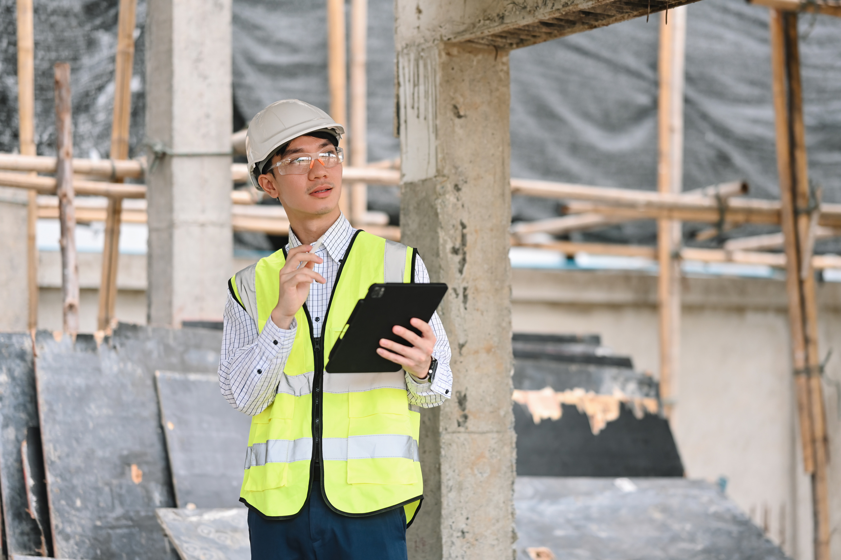
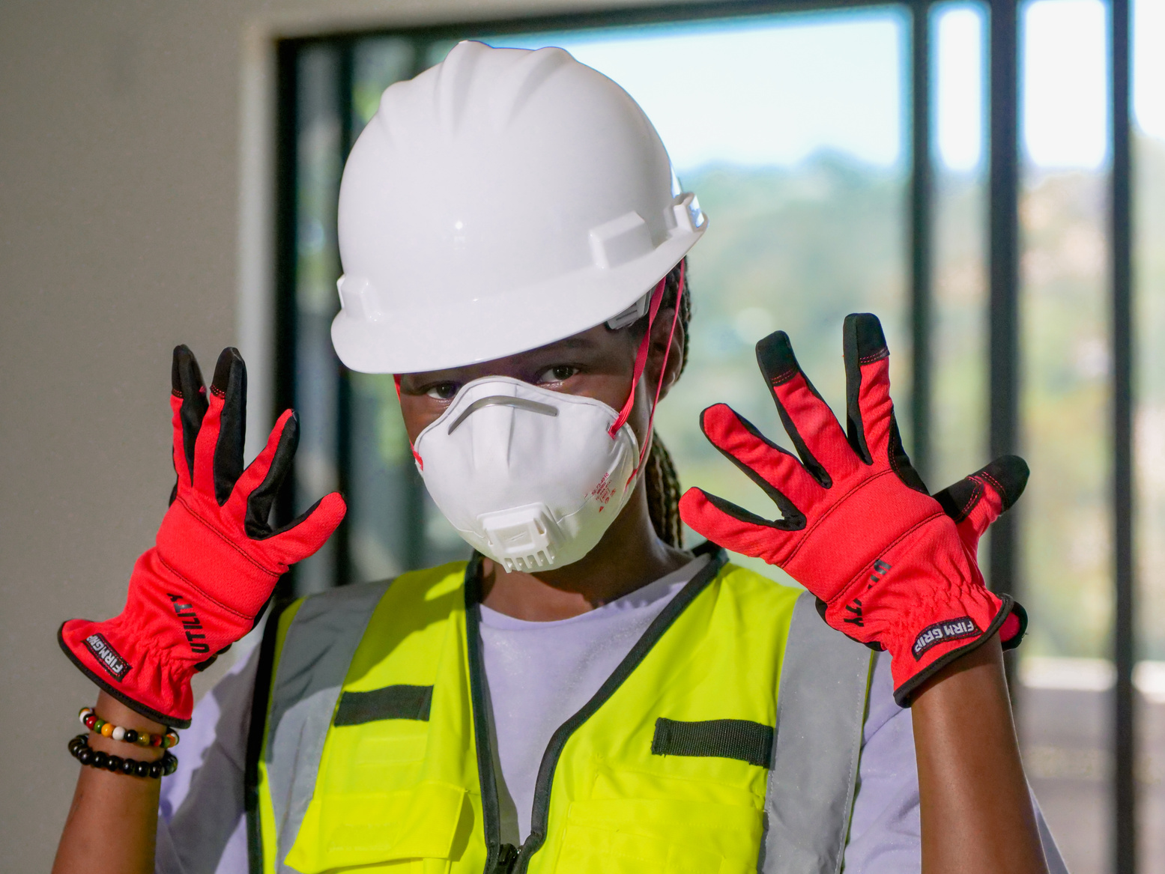
PPE SYSTEM
Home
Services
Features
About Us
Let’s Talk
DATA PLAN
Source
Dataset (Kaggle) : Construction_Site_Safety_Image_Dataset
Size
~2,800 images (train/valid/test pre-split)
Labels (Classes)
Preparation
What's Already Done:
✓ Fully labeled with bounding boxes
✓ Pre-split into train/valid/test directories
✓ Pre-processed to standard resolution
Key PPE Classes:
Hardhat, NO-Hardhat
Safety Vest, NO-Safety Vest
Mask, NO-Mask
Person
Additional: Gloves, machinery, vehicles (~25 total classes)
Format: YOLO annotation format (.txt files with bounding boxes)
What We'll Do:
Download from Kaggle
Verify annotation format
Apply augmentation during training (rotation, brightness, flips)
YOLOv8 does this automatically
License: CC BY 4.0 (open for research and demo use)

Slide 6
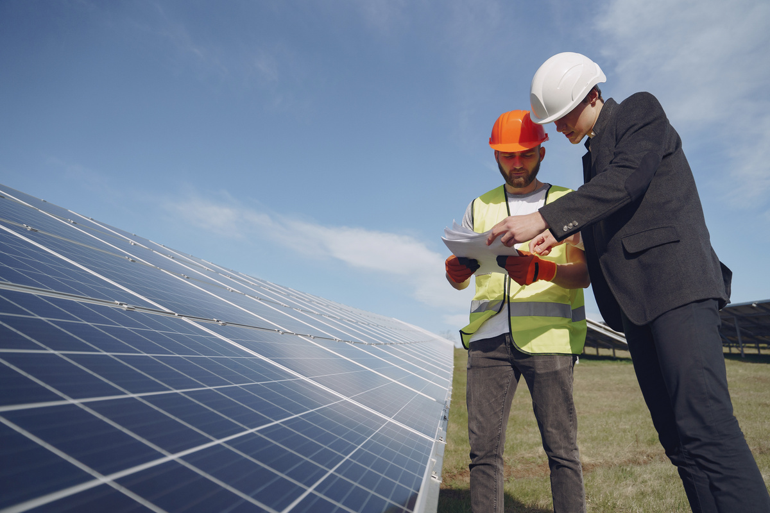
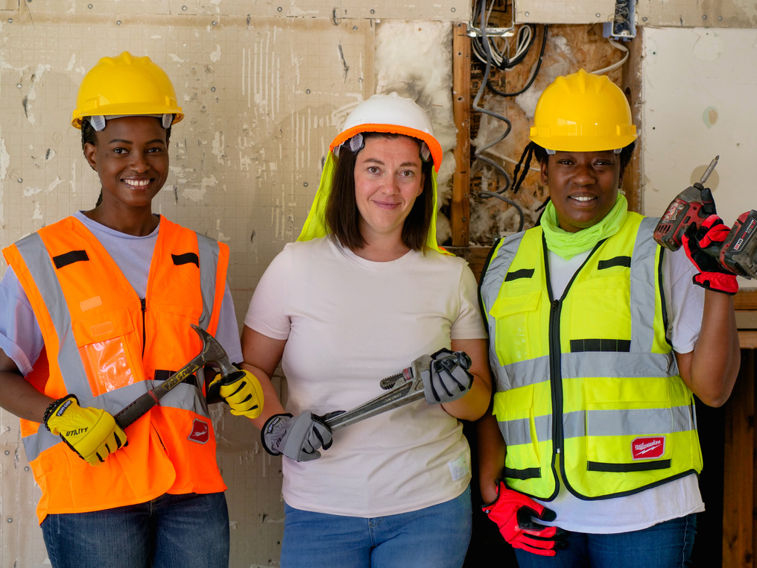
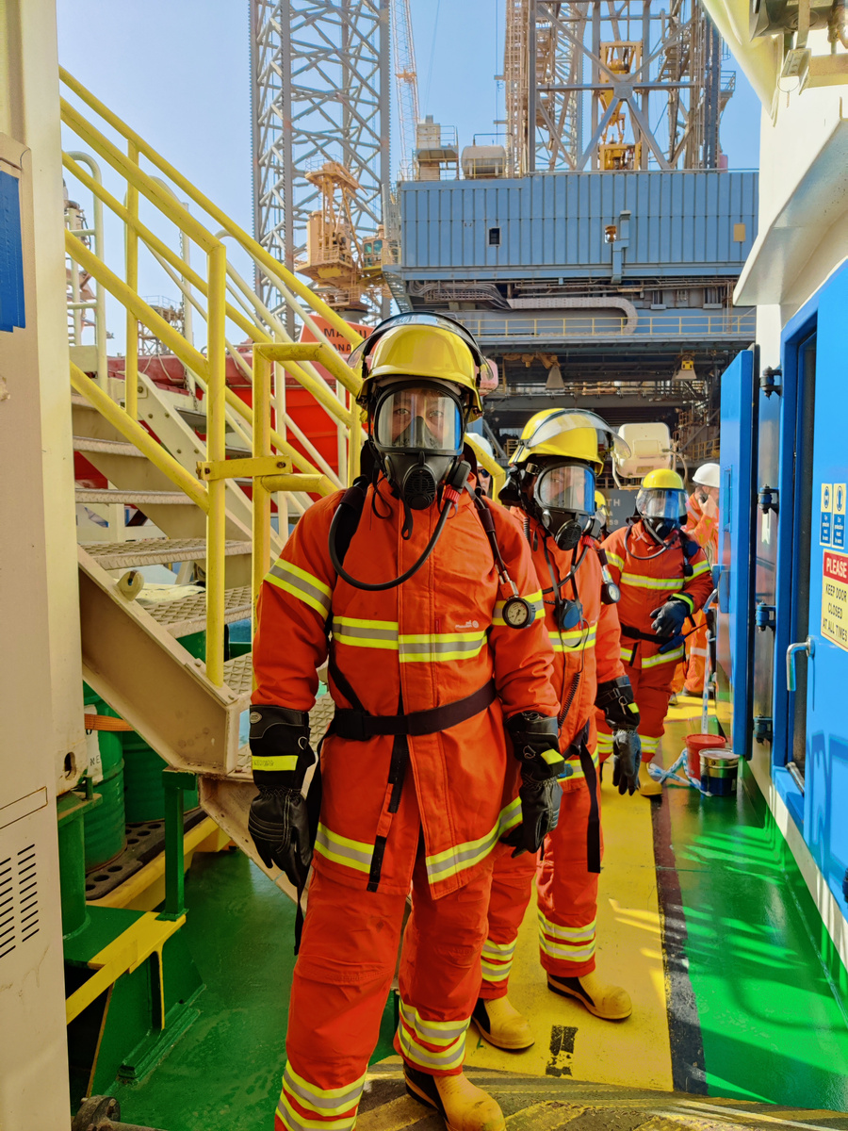
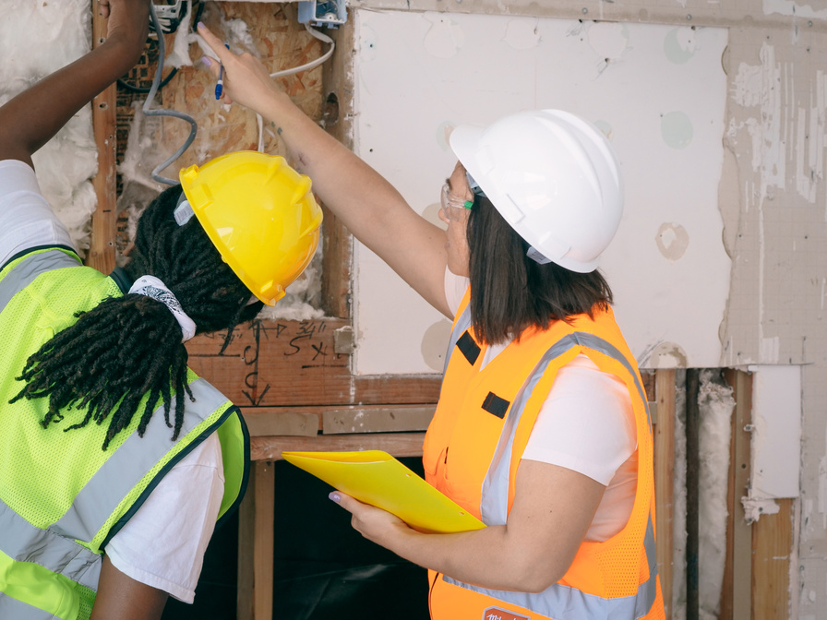

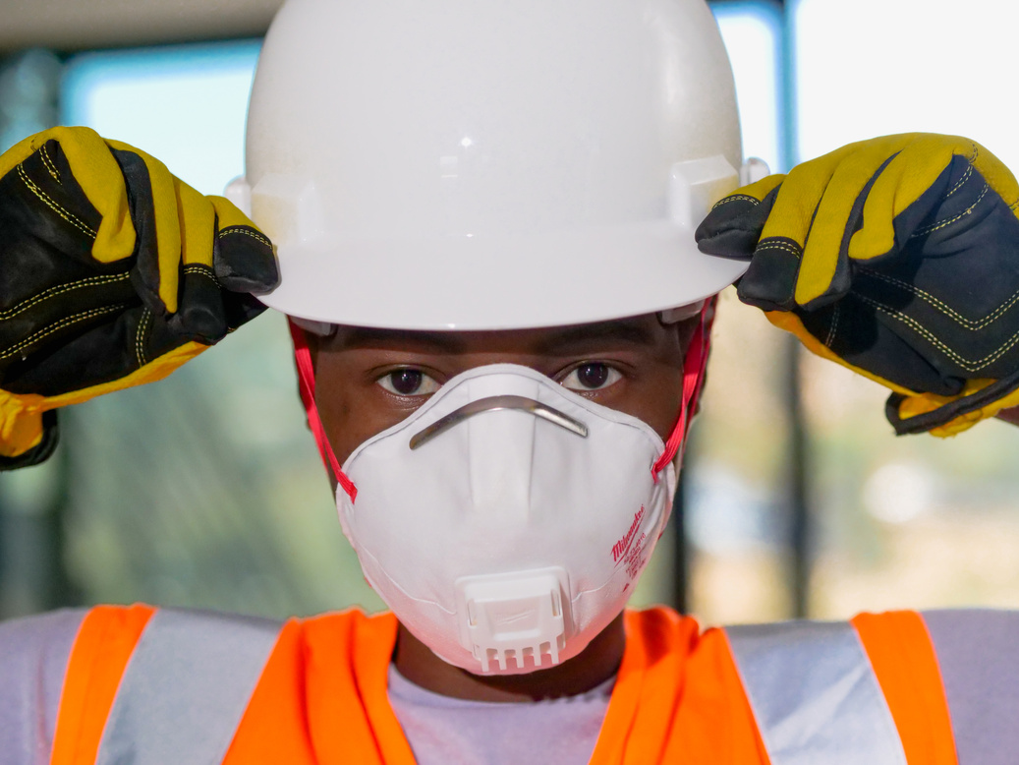
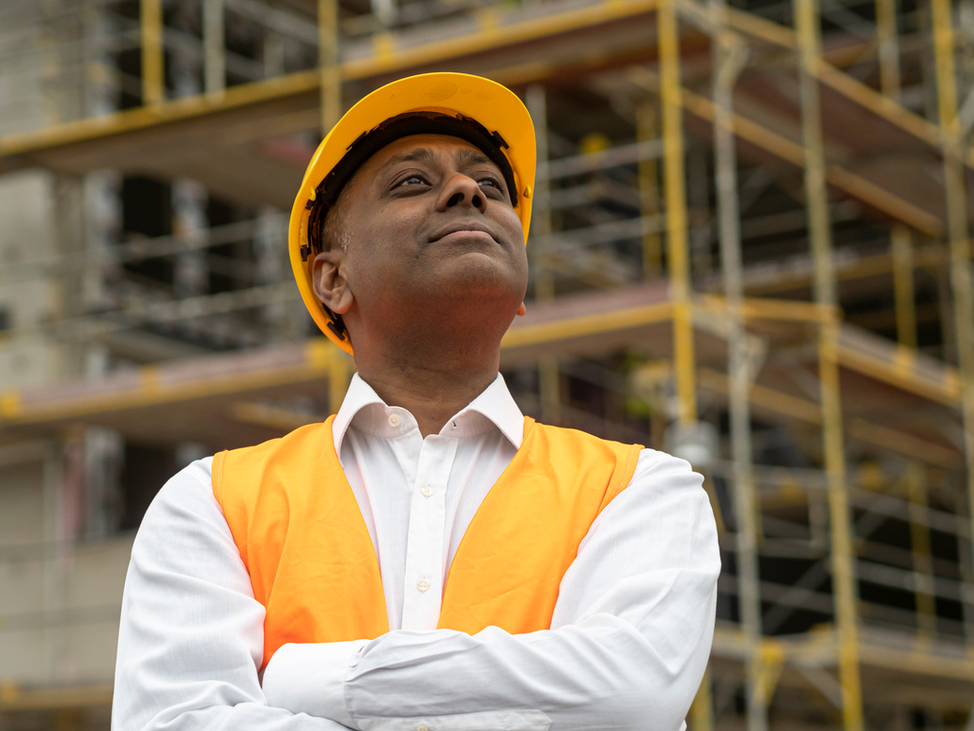
PPE SYSTEM
Home
Services
Features
About Us
Let’s Talk
Pipeline Flow
SYSTEM DIAGRAM
Input: Camera Feed
(Image or Video)
Preprocessing
Resize to 640x640
Normalize
YOLOv8 Detection
Detect PPE items
Localize worker
Major Steps:
1. Acquisition: Capture image/video from workplace cameras.
2. Preprocessing: Resize and normalize input.
3. Model Inference: YOLOv8 detects PPE items and workers.
4. Compliance Logic: Rule engine checks for required PPE.
5. Output: Visual overlays + compliance reports
Compliance Check
Helmet present?
Vest present?
Mask present?
Output:
Annotated Image
Compliance Report
Real-Time Alerts

Slide 7
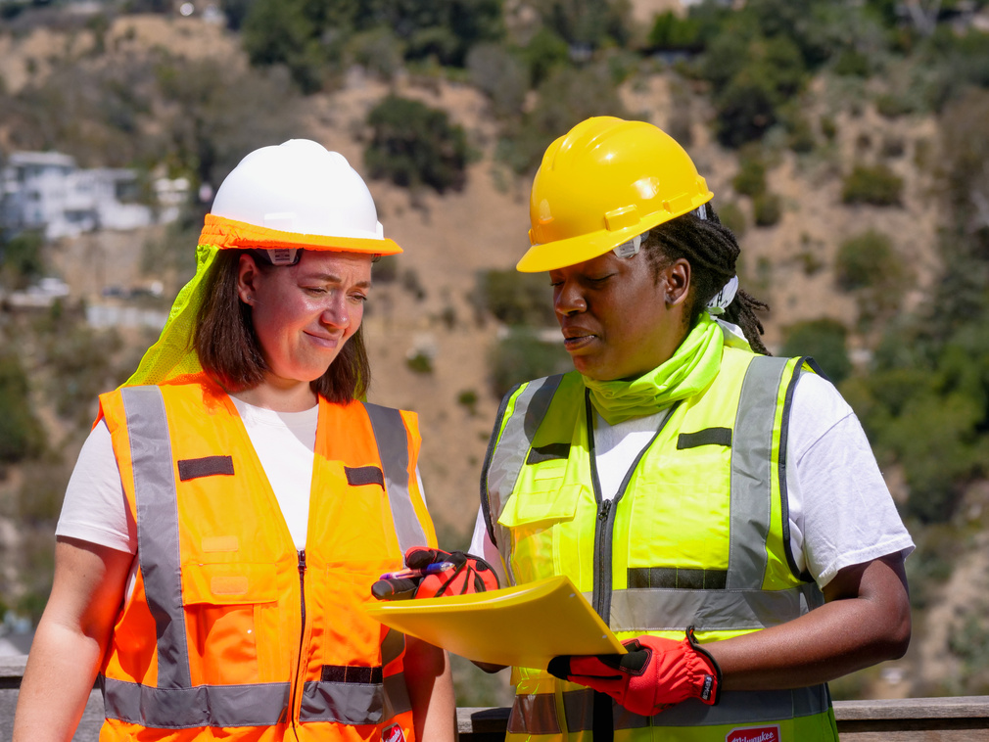

PPE SYSTEM
Home
Services
Features
About Us
Let’s Talk
SUCCESS METRICS
Metric Type | Metric | Target | Rationale
Primary | mAP@50 (Detection Accuracy) | ≥80% | Acceptable for workplace safety
Primary | Precision | ≥88% | Minimize false positives (avoid false alarms)
Primary | Recall | ≥75% | Catch most actual violations
Secondary | Inference Speed (CPU) | <100ms per image | Real-time feasibility
Secondary | Per-Class F1 Score | ≥0.80 per PPE type | Balanced performance across classes
Why These Metrics:
mAP@50: Standard object detection metric (mean average precision at 0.5 IoU)
Precision: High precision avoids annoying workers with false alarms
Recall: High recall ensures we catch most safety violations
Speed: Real-time monitoring requires fast inference
Benchmarks: YOLOv8 achieves 90%+ mAP on standard benchmarks; our target of 80%+ is realistic for this dataset size [Ultralytics Performance Guide, 2025]

Slide 8

PPE SYSTEM
Home
Services
Features
About Us
Let’s Talk
WEEK-BY-WEEK PLAN
Key Milestones Detail:
Week | Date | Task | Milestone
10 | Oct 30 | Download dataset, set up environment, initial exploration | Dataset ready; Midterm presentation submitted
11 | Nov 6 | Train YOLOv8 model on PPE dataset | Model working; achieves ≥75% mAP
12 | Nov 13 | Test model, improve accuracy with augmentation | Good accuracy (≥80% mAP)
13 | Nov 20 | Build compliance logic, create demo with visual overlays | Demo ready; system functional
14 | Nov 27 | Record demo video, final testing, documentation | Everything done; GitHub finalized
15 | Dec 4 | Present project in class | 🎉 Presentation day
Week 10: Download Kaggle dataset, set up Google Colab with PyTorch/YOLOv8, create GitHub repo, explore data
Week 11: Train YOLOv8-small for 50–100 epochs, monitor metrics, save best checkpoint
Week 12: Evaluate on test set, apply augmentation, retrain, improve to 80%+ mAP
Week 13: Write compliance rule engine, create inference script, annotate output images
Week 14: Record 3–5 min demo video, finalize code/docs, prepare presentation
Week 15: Live or recorded demo during final presentation

Slide 9
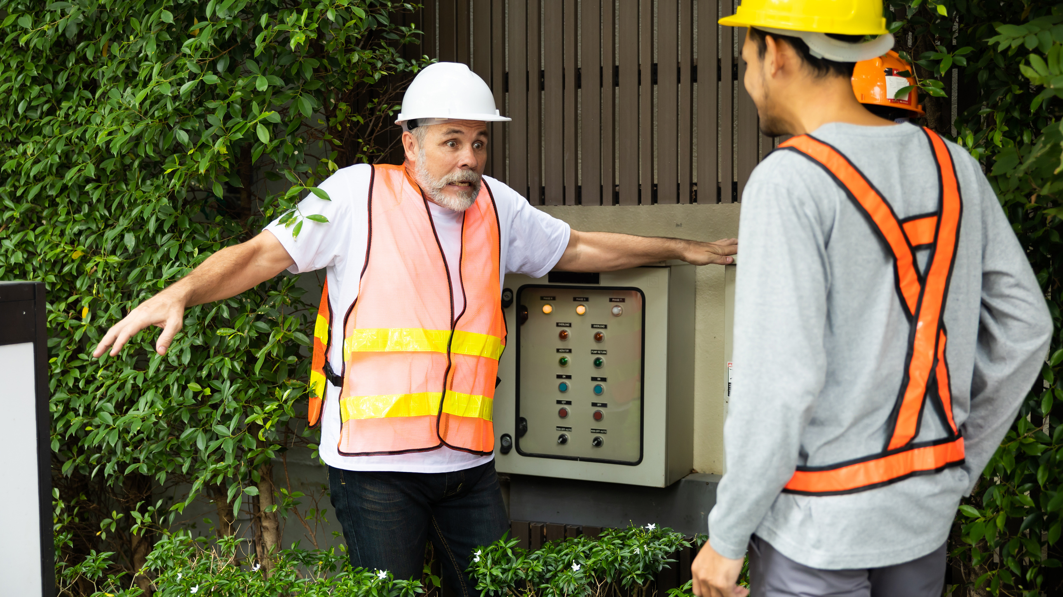
PPE SYSTEM
Home
Services
Features
About Us
Let’s Talk
CHALLENGES & BACKUP PLANS
Potential Challenges & Solutions
Risk Management:
Challenge | Probability | Plan B / Mitigation
Accuracy < 80% | Medium | Apply aggressive augmentation; try YOLOv8-medium; fine-tune on hard examples
Class imbalance (some PPE rare) | Medium | Use weighted loss functions; class-specific augmentation
Occluded PPE (workers blocked) | Medium | Train with occlusion patterns; adjust confidence thresholds
Lighting variability | High | YOLOv8 handles well with augmentation; test various lighting
Slow inference on CPU | Low | Use YOLOv8-nano (faster); optimize with quantization; ensure GPU available
Insufficient training data | Low | Combine with SH17 dataset (8,099 images); aggressive augmentation
Demo technical failure | Low | Record backup video in advance; prepare static image demo
If model underperforms: Fine-tune hyperparameters, try larger model variant, add more data
If time runs short: Focus on core features first (detection + basic compliance), add extras if time allows
If deployment issues: Prepare demo on static images instead of live video processing

Slide 10
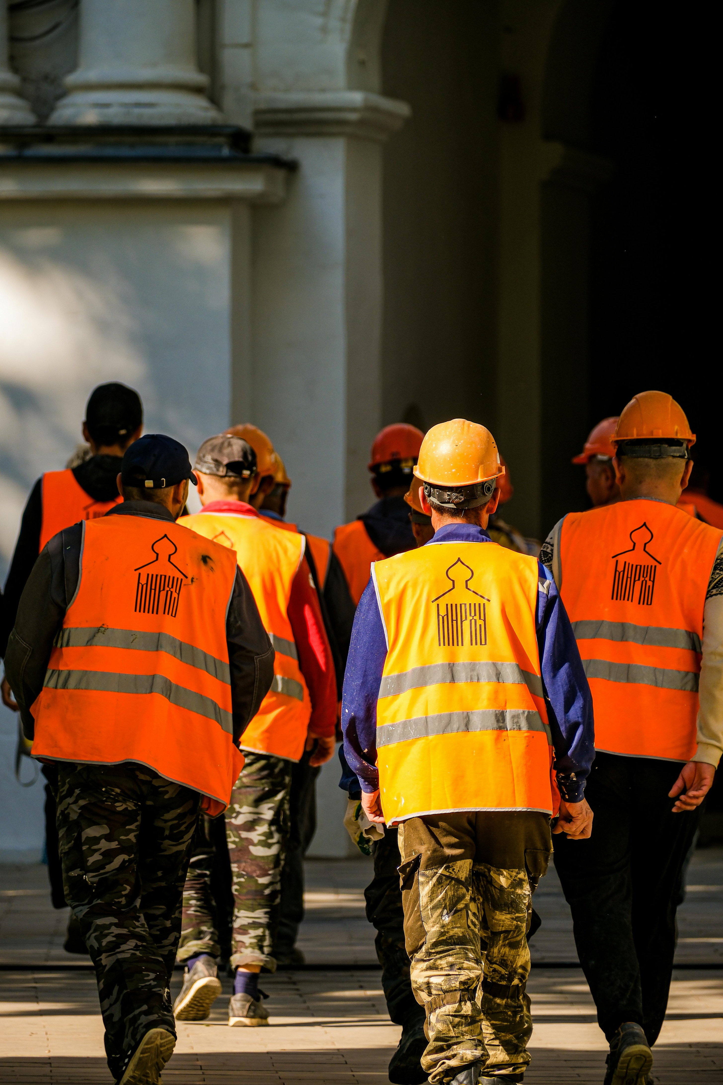
PPE SYSTEM
Home
Services
Features
About Us
Let’s Talk
RESOURCES NEEDED
Resource | Options / Notes | Cost
Compute | Google Colab (Free or Pro), Kaggle Notebooks | $0–$10/month
GPU Training | Colab free tier (12–16GB GPU) | $0
CPU Inference | Any modern laptop/desktop | $0
Frameworks | PyTorch, Ultralytics YOLO, OpenCV | $0 (open source)
Dataset | Kaggle (direct download) | $0
APIs | Kaggle API (optional), Ultralytics HUB (optional) | $0 (free tiers)
Storage | Google Drive (15GB free), Colab storage | $0
Code Repository | GitHub (private repo) | $0
Software Stack:
Python 3.7+
PyTorch (deep learning)
Ultralytics YOLO (model training/inference)
OpenCV (image processing & visualization)
NumPy, Pandas, Matplotlib (data science tools)
Total Estimated Cost: $0 (fully achievable with free resources)
Optional: Google Colab Pro ($10/month) if free tier GPU is insufficient – but not required for this project

Slide 11
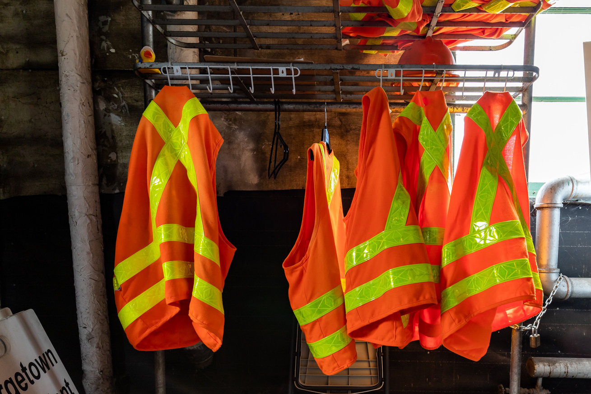
PPE SYSTEM
Home
Services
Features
About Us
Let’s Talk
REFERENCES & SOURCES
Workplace Safety Statistics:
1. U.S. Bureau of Labor Statistics (2024). "Occupational Injuries and Illnesses." BLS.gov
2. OSHA, U.S. Department of Labor (2025). "Construction Industry Safety Resources." OSHA.gov
Dataset:
3. Kaggle: Construction_Site_Safety_Image_Dataset_Roboflow
Technical References:
4 Ultralytics (2025). "YOLOv8 Documentation." : https://docs.ultralytics.com
3. Ultralytics (2025). "YOLO Performance Metrics Guide." : https://docs.ultralytics.com/guides/yolo-performance-metrics/
Presentation Prepared: October 28, 2025
Submission Deadline: October 30, 2025
Final Project Due: December 4, 2025

